Slide 1



Personal Splitwise TRACKER
Personal Expense Management Simplified

Slide 2




About US

Slide 3

Intent and Goals
Objective: Develop an intuitive web-based application that allows users to easily track and manage their personal and shared expenses.
Goals: Facilitate seamless tracking of personal and group expenses.
Provide analytical insights into spending patterns.
Enhance user experience with automated expense-splitting features.
Ensure secure and private management of financial data.

Slide 4


WebPage Demostration

Slide 5

Key learnings
Challenges in implementing real-time data synchronization.
Techniques for ensuring data security and privacy.

Slide 6
Future enhancement
User Profile: Allow users to create profiles for personalized financial management.
Budgeting: Set and Track monthly or yearly Budgets for different categories.
Advanced Analytics: Provide Detailed insights into spending patterns and trends
Goal Setting: Set and Monitor progress towards financial goals.
Reminder System: Set Reminders for recurring Expenses and Income

Slide 7
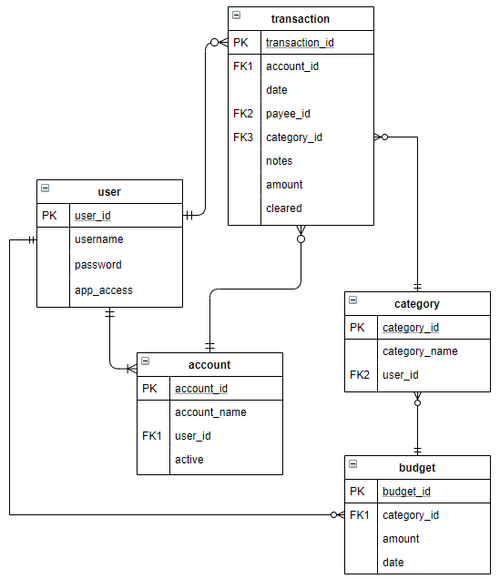
Database Schema

